Slide 1
BLOCKCHAIN TECHNOLOGY
SANJAY MAKWANA

Slide 2
Cryptography Hash Functions
A cryptographic hash function (CHF) is an equation that is widely used to verify the validity of data. It has many applications, particularly in information security (e.g. user authentication).
A CHF translates data of various lengths of the message into a fixed-size numerical string the hash.
A cryptographic hash function is a single-directional work, making it extremely difficult to reverse to recreate the information used to make it.

Slide 3
How Does a Cryptography Hash Function Work?
The hash function accepts data of a fixed length. The data block size varies between algorithms.
If the blocks are too small, padding may be used to fill the space. However, regardless of the kind of hashing used, the output, or hash value, always has the same set length.
The hash function is then applied as many times as the number of data blocks.

Slide 4
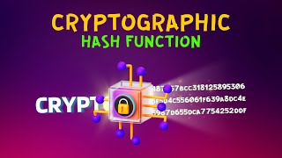

Slide 5
Applications of Cryptographic Hash Functions
Message Authentication
Data Integrity Check
Digital Signatures

Slide 6
Characteristics of Cryptographic Hash functions
Deterministic
Fast Computation
Preimage Resistance (One-way property)
Second Pre-image Resistance
Collision Resistance
Avalanche Effect
Fixed Output Length
Pseudorandomness

Slide 7
DEMO OF HASHING
https://tools.superdatascience.com/blockchain/hash/

Slide 8
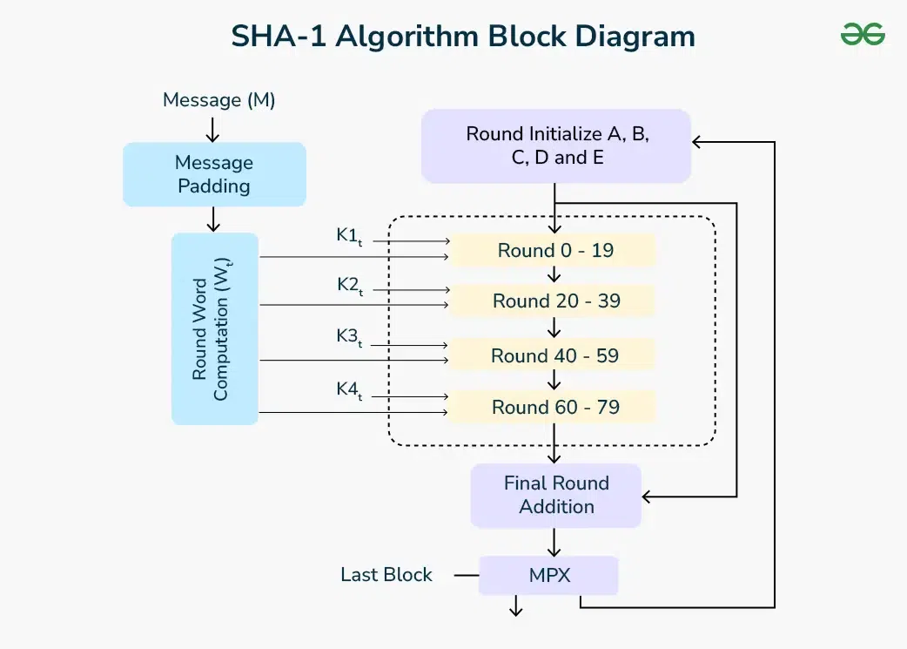
SHA-1 Hash

Slide 9
Cryptographically Secured
"Cryptographically secured" means that a system, data, or communication is protected using cryptographic methods to ensure confidentiality, integrity, authenticity, and non-repudiation.
Cryptography is the science of securing information using mathematical techniques, typically involving encryption and decryption.When something is cryptographically secured, it means that security relies on cryptographic algorithms to prevent unauthorized access or tampering.

Slide 10
Key Aspects of Cryptographic Security
Confidentiality
Integrity
Authentication
Non-repudiation

Slide 11
Key Aspects of Cryptographic Security
Aspect | Purpose
Confidentiality | Ensures that only authorized parties can access the information (e.g., using encryption)
Integrity | Ensures the data hasn’t been altered (e.g., using hash functions like SHA-256)
Authentication | Confirms the identity of users or systems (e.g., using digital signatures)
Non-repudiation | Ensures that a party cannot deny the authenticity of a message they sent (e.g., using public key cryptography)

Slide 12
What is a Digital Signature?
A digital signature is a cryptographic technique used to prove the authenticity and integrity of a message, document, or software. It's the digital equivalent of a handwritten signature or a stamped seal, but much more secure because it uses mathematical algorithms

Slide 13
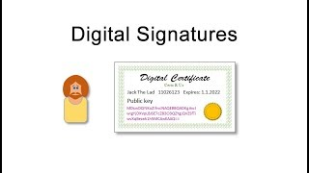

Slide 14
Applications of Digital Signatures
Application | Purpose
E-Government Forms | Verifying citizen identity (e.g., Aadhaar e-sign)
Software Distribution | Ensures the software hasn’t been tampered
Blockchain & Crypto | Signs transactions to ensure authenticity
Secure Email (PGP, S/MIME) | Confirms sender and message integrity
Legal Documents | Digital contracts and e-signatures

Slide 15
Public Key Cryptography (Asymmetric Key Cryptography)
Public Key Cryptography is a method of encrypting and securing data using two different but mathematically related keys:
A public key (shared with everyone)
A private key (kept secret)

Slide 16
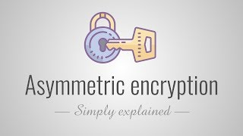

Slide 17
RSA Algorithm
RSA Algorithm is based on factorization of large numbers and modular arithmetic for encrypting and decrypting data. It consists of three main stages:
1.Key Generation: Creating Public and Private Keys
2.Encryption: Sender encrypts the data using Public Key to get cipher text.
3.Decryption: Decrypting the cipher text using Private Key to get the original data.

Slide 18


Slide 19
Chain of Blocks
Blockchain, as the term suggests, is a chain of blocks. In more technical terms, Blockchain is a decentralized and distributed database.
Think of it like a google doc that stores information which is shared and controlled by everyone.
Decentralized & Distributed: This means that no singular individual or entity has control over the Blockchain. It’s entirely decentralized, meaning that it’s controlled by multiple participants and distributed across the network. This technology is known as the Distributed Ledger Technology (DLT).

Slide 20
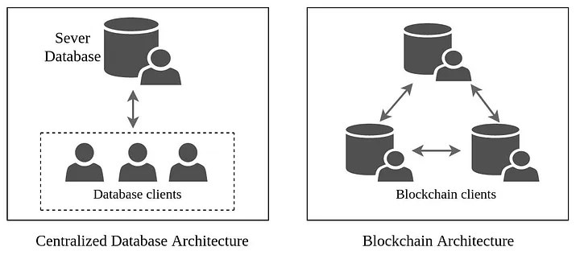
Chain of Blocks

Slide 21
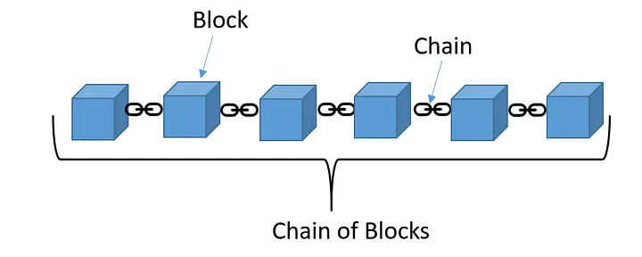
Chain of Blocks
Each piece of data on the blockchain is stored in a block, and all the blocks of data are chained together.

Slide 22
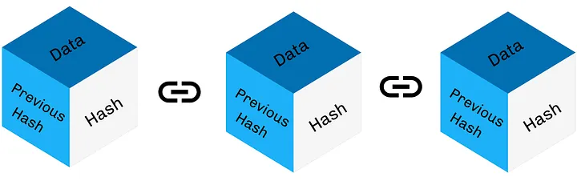
Chain of Blocks

Slide 23
Chain of Blocks
Data: This is the information that will be permanently stored on the public ledger. For example: When a transaction takes place, the block will contain the information about the sender, the receiver, the timestamp etc.
Hash: Cryptographic Hashing, in very simple terms is converting the big data stored on the block into a unique set of letters and numbers that has a fixed length. It’s like a mathematical fingerprint of that specific data.
Hash of the previous block: The next block in the chain will also contain the hash of the previous block.

Slide 24
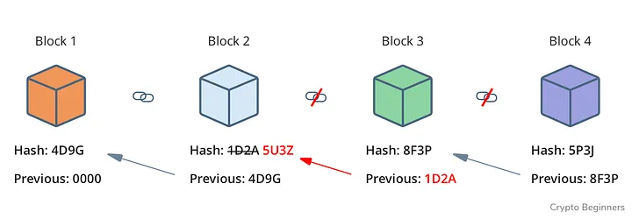
https://tools.superdatascience.com/blockchain/hash/

Slide 25
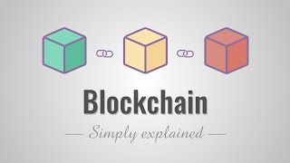

Slide 26
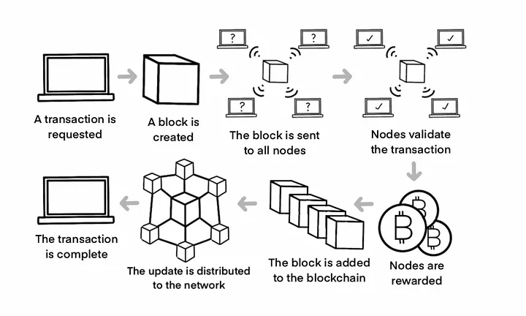

Slide 27
Merkle Trees
A Merkle tree is fundamentally just a hierarchical set of hash values, building from a set of actual data (Merkle leaf) to intermediate hashes (Merkle branches) and up to the Merkle root that summarizes all the data in one hash value

Slide 28
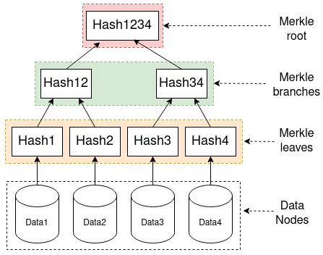

Slide 30
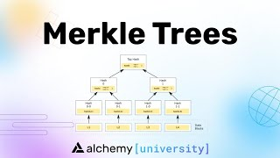

Slide 31
Smart Contract
A Smart Contract (or crypto contract) is a computer program that directly and automatically controls the transfer of digital assets between the parties under certain conditions. A smart contract works in the same way as a traditional contract while also automatically enforcing the contract. Smart contracts are programs that execute exactly as they are set up(coded, programmed) by their creators. Just like a traditional contract is enforceable by law, smart contracts are enforceable by code.

Slide 32


Slide 33
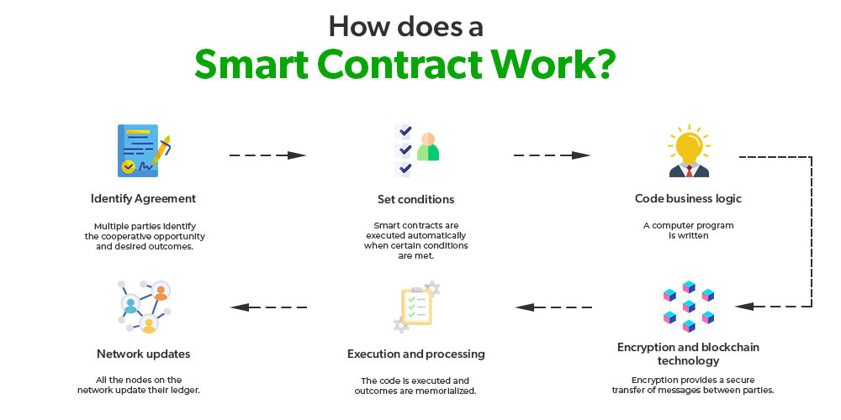

Slide 34
Features of Smart Contracts
Distributed: Everyone on the network is guaranteed to have a copy of all the conditions of the smart contract and they cannot be changed by one of the parties. A smart contract is replicated and distributed by all the nodes connected to the network.
Deterministic: Smart contracts can only perform functions for which they are designed only when the required conditions are met. The final outcome will not vary, no matter who executes the smart contract.

Slide 35
Features of Smart Contracts
Immutable: Once deployed smart contract cannot be changed, it can only be removed as long as the functionality is implemented previously.
Autonomy: There is no third party involved. The contract is made by you and shared between the parties. No intermediaries are involved which minimizes bullying and grants full authority to the dealing parties. Also, the smart contract is maintained and executed by all the nodes on the network, thus removing all the controlling power from any one party's hand.

Slide 36
Features of Smart Contracts
Customizable: Smart contracts have the ability for modification or we can say customization before being launched to do what the user wants it to do.
Transparent: Smart contracts are always stored on a public distributed ledger called blockchain due to which the code is visible to everyone, whether or not they are participants in the smart contract.

Slide 37
Features of Smart Contracts
Trustless: These are not required by third parties to verify the integrity of the process or to check whether the required conditions are met.
Self-verifying: These are self-verifying due to automated possibilities.
Self-enforcing: These are self-enforcing when the conditions and rules are met at all stages.

Slide 38
Features of Smart Contracts
Trustless: These are not required by third parties to verify the integrity of the process or to check whether the required conditions are met.
Self-verifying: These are self-verifying due to automated possibilities.
Self-enforcing: These are self-enforcing when the conditions and rules are met at all stages.

Slide 39
Advantages of Smart Contracts
Recordkeeping: All contract transactions are stored in chronological order in the blockchain and can be accessed along with the complete audit trail. However, the parties involved can be secured cryptographically for full privacy.
Autonomy: There are direct dealings between parties. Smart contracts remove the need for intermediaries and allow for transparent, direct relationships with customers.

Slide 40
Advantages of Smart Contracts
Reduce fraud: Fraudulent activity detection and reduction. Smart contracts are stored in the blockchain. Forcefully modifying the blockchain is very difficult as it's computation-intensive. Also, a violation of the smart contract can be detected by the nodes in the network and such a violation attempt is marked invalid and not stored in the blockchain.

Slide 41
Advantages of Smart Contracts
Fault-tolerance: Since no single person or entity is in control of the digital assets, one-party domination and the situation of one part backing out do not happen as the platform is decentralized and so even if one node detaches itself from the network, the contract remains intact.
Enhanced trust: Business agreements are automatically executed and enforced. Plus, these agreements are immutable and therefore unbreakable and undeniable.

Slide 42
Advantages of Smart Contracts
Cost-efficiency: The application of smart contracts eliminates the need for intermediaries(brokers, lawyers, notaries, witnesses, etc.) leading to reduced costs. Also eliminates paperwork leading to paper saving and money-saving.

Slide 43
Challenges of Smart Contracts
No regulations: A lack of international regulations focusing on blockchain technology(and related technology like smart contracts, mining, and use cases like cryptocurrency) makes these technologies difficult to oversee.
Difficult to implement: Smart contracts are also complicated to implement because it's still a relatively new concept and research is still going on to understand the smart contract and its implications fully.

Slide 44
Challenges of Smart Contracts
Immutable: They are practically immutable. Whenever there is a change that has to be incorporated into the contract, a new contract has to be made and implemented in the blockchain.

Slide 45
Centralized vs Distributed System
Aspect | Centralized System | Distributed System
Control | Centralized control and authority | Decentralized control and authority
Resource Management | All resources managed centrally | Resources distributed across multiple nodes
Communication | Communication flows to central node | Direct communication between nodes

Slide 46
Centralized vs Distributed System
Aspect | Centralized System | Distributed System
Fault Tolerance | Single point of failure | Redundancy, less vulnerable to single points of failure
Scalability | Limited scalability due to centralization | Highly scalable, new nodes can be added easily
Complexity | Relatively simpler to manage | More complex to manage

Slide 47
Actors Blockchain solution
Actors are the participants who interact with the blockchain network in various roles.
Users / Clients
Nodes / Peers
Miners / Validators
Developers
Administrators / Network Operators
Smart Contracts

Slide 48
Actors Blockchain solution
Users / Clients
Role: End-users who initiate transactions or use blockchain-based applications.
Example: A person sending cryptocurrency or using a dApp (Decentralized App).
Nodes / Peers
Role: Computers connected to the blockchain network that maintain copies of the ledger and participate in consensus.
Types of Nodes:
Full Node: Stores the entire blockchain and validates transactions and blocks.
Light Node: Stores only necessary parts of the blockchain, relies on full nodes for validation.

Slide 49
Actors Blockchain solution
Miners / Validators
Role: Participants who validate transactions and add new blocks to the blockchain.
Mechanisms:
Proof of Work (PoW): Used in Bitcoin, miners solve puzzles.
Proof of Stake (PoS): Used in Ethereum 2.0, validators are selected based on stake.
Developers
Role: Build and maintain blockchain platforms, smart contracts, and applications.
Tools Used: Solidity (Ethereum), Rust (Solana), Go (Hyperledger), etc.

Slide 50
Actors Blockchain solution
Administrators / Network Operators
Role: Manage permissions, monitor the network, and ensure security (mainly in permissioned blockchains like Hyperledger Fabric).
Smart Contracts
Role: Self-executing programs stored on the blockchain that run when predefined conditions are met.
Used For: Automating workflows (e.g., payments, asset transfers, governance rules).

Slide 51
Components of a Blockchain Solution
Distributed Ledger
Consensus Mechanism
Cryptography
Smart Contracts
Wallets
Blockchain Protocol
Peer-to-Peer (P2P) Network
Tokens / Cryptocurrencies

Slide 52
Components of a Blockchain Solution
Distributed Ledger
Definition: A replicated, synchronized database shared across nodes.
Purpose: Ensure transparency and data immutability.
Consensus Mechanism
Definition: Protocol to agree on the validity of transactions.
Common Types:
Proof of Work (PoW)
Proof of Stake (PoS)
Practical Byzantine Fault Tolerance (PBFT)
Delegated Proof of Stake (DPoS)

Slide 53
Components of a Blockchain Solution
Cryptography
Role: Ensures security and privacy.
Types Used:
Hashing (SHA-256): Converts input into a fixed-size hash.
Public/Private Keys: Used for digital signatures and transaction authorization.
Smart Contracts
Functionality: Automates and enforces rules without intermediaries.
Languages: Solidity (Ethereum), Chaincode (Hyperledger Fabric).

Slide 54
Components of a Blockchain Solution
Wallets
Purpose: Store private/public keys and allow users to send/receive crypto.
Types:
Hot Wallets (online)
Cold Wallets (offline, more secure)
Blockchain Protocol
Definition: Set of rules defining how data is structured, added, and communicated.
Examples: Bitcoin protocol, Ethereum protocol, Hyperledger Fabric protocol.

Slide 55
Components of a Blockchain Solution
Peer-to-Peer (P2P) Network
Function: Enables direct communication between nodes without a central server.
Benefit: Decentralization and fault tolerance.
Tokens / Cryptocurrencies
Purpose: Represent value or utility on the blockchain.
Example: ETH on Ethereum, BTC on Bitcoin.

